Slide 1


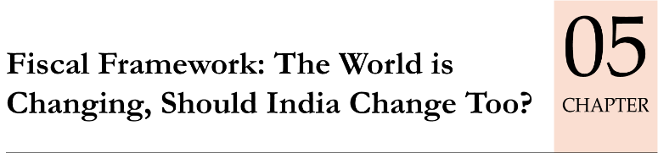
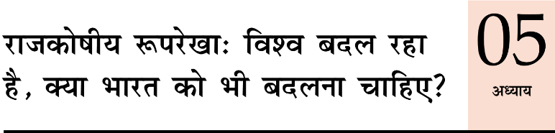
Economy: 6 pillars + theory + current + BES17 (pre cum Mains)
1.Banking, Fin, Insur.
6.HRD
2.Budget
3.BoP & intl. Trade
4.Sectors
5.Infra
V1:c3,4
V1:c2,3, 6,9,11(GST),13
V1c:5
V1c:7,11(Agri)
V1c:10
v1c:12, 14; Budget^Rail
BES173: theory, current
BoP-Current
BoP-Capital
Orgs
Survey Ch.5

Slide 2
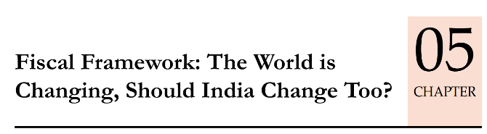
AE
Counter cyclic: Fiscal Activism, stimulus
Near Zero interest monetary policy
India
Fiscal prudence : Debt:GDP, Primary Deficit is high
Inflation is high, so can't do.
Fiscal Policy
Monetary Policy
Notes:
boost in demand, indirect tax will pay for itself

Slide 3
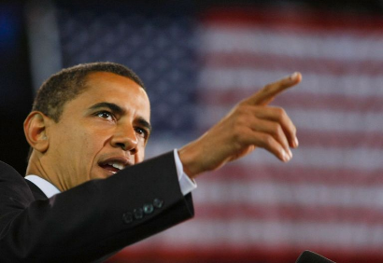
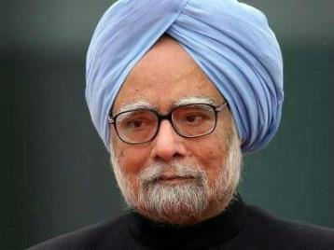
Fiscal “Stimulus”: Temporary “Counter Cyclic” Measure
है दम?
2009-13
आज कुछ “तूफानी” करते है!
2009-11
2013: Excise Small vehicles: 12%->8%
Exporters: Interest Subvention, duty relief
Relaxed norms to buy new Government vehicles
Plan Expenditure raised by 20k cr.
Bigger allocations for MNREGA, RTE, PDS etc.
Laborer: income, bizmen: tender-demand, production ▲
Tax Cut, Tax Rebates, Loan subsidies: to boost demand & production.
Martin Luther King NREGA: Federal “Contracts” for new bridges, roads, buildings, community centre

Slide 4
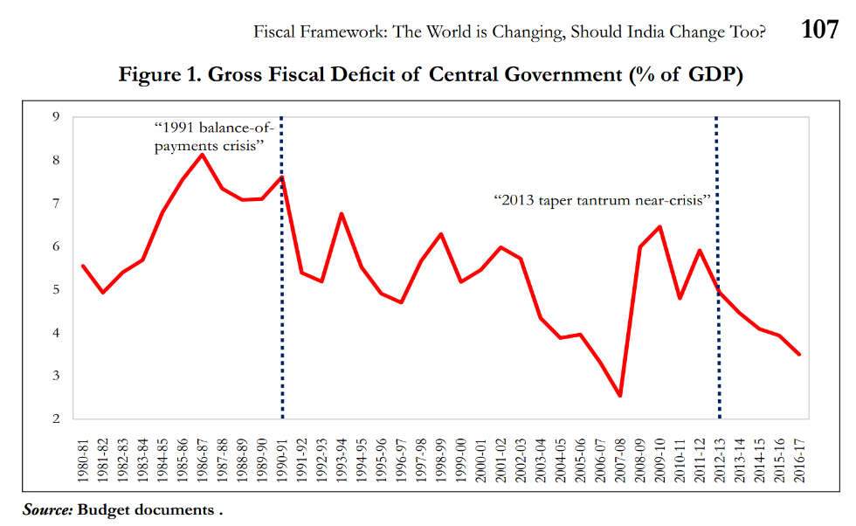

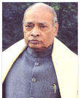
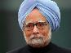
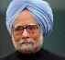
2013: crisis,
High inflation
$1 = 69 rupees
RTE 2010
“Stimulus” 2009
MNREGA 2006
For India: Fiscal stimulus, fiscal deficit led “growth” is a problem rather “Solution”, because of Low Tax Base, “Leakages”->Inflation.

Slide 5
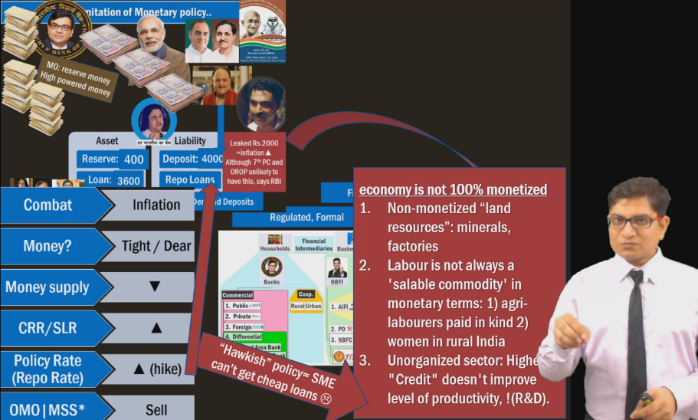
How fiscal stimulus: “Subsidies-leakage”-> inflation? Self study

Slide 6
Mock Question for Prelims
A) Government of India should pursue a path of fiscal prudence rather than fiscal activism.
R) In India, economic crisis are usually succeeded by high level of fiscal deficit.
Answer Options:
Both are correct and R explains A
Both are correct but R doesn’t explain A
A is right but R is wrong.
R is right but A is wrong.

Slide 7
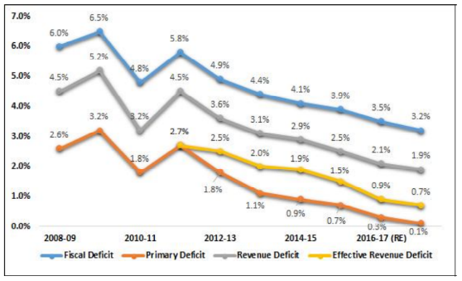

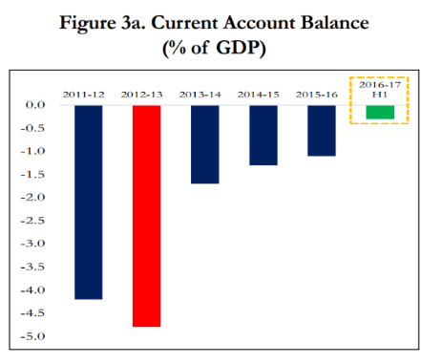
High level of Fiscal Deficit
TWIN DEFICIT
High level of CAD

Slide 8
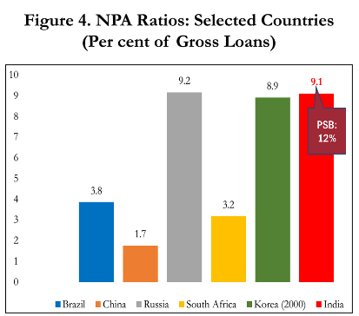
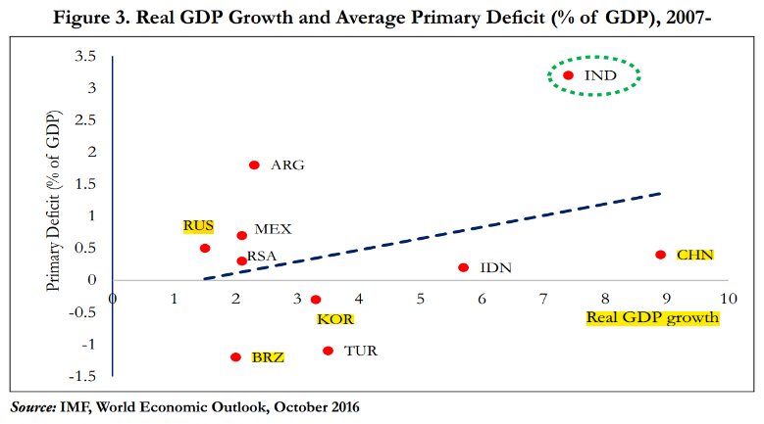
Our Debt to GDP is high ☹

Slide 9
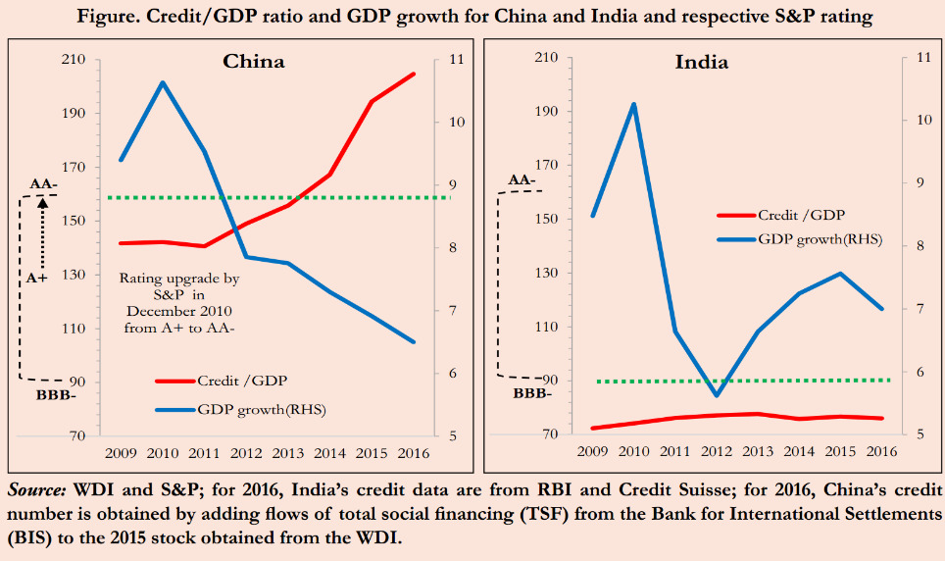
S&P: AAA rating to toxic assets that led to subprime crisis. India never defaulted on payment, yet in BBB grade, while China’s GDP growth falling yet, rank improving! <lecture link>

Slide 10
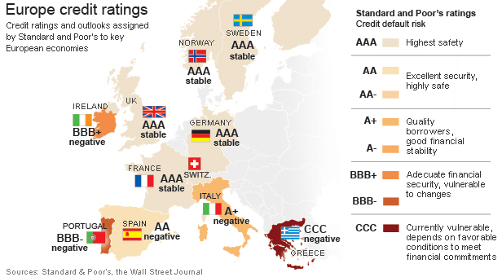
Still, if we try for “debt” led growth or Government funded bad bank, takes over NPA..
Then it can lead to..
Sovereign Debt Crisis (2009-)
Greece: threatens to walk out
Fiscal Deficit, “Downsizing” PSUs, “Cut Welfare Programs” (Austerity)
2017, April: restarted Negotiation.
Rating: CCC, “Bank runs”, “investors runs”.
EU members “Conditional help” (Bailout)
India
As such ‘step-motherly’ treatment by foreign rating agencies.
If we get CCC rating- there is no “EU” to help us, since SAARC- all poor, AIIB/BRICS : China may oppose or put strict conditions.

Slide 11
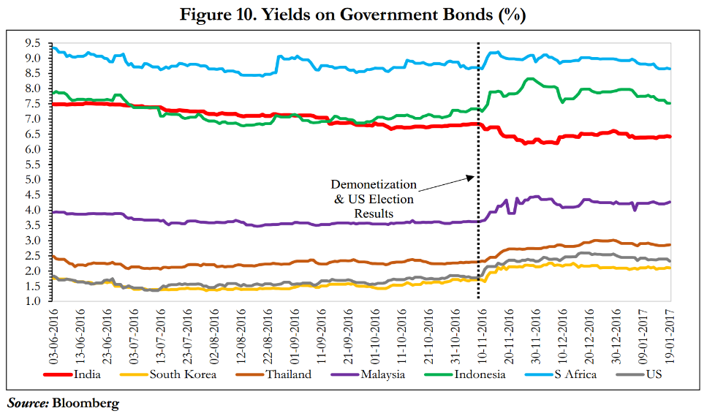
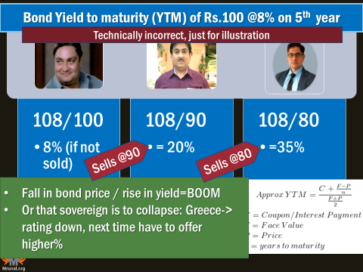
What is bond yield, how it was affected by Trump election and Demonetization…already taught (LINK). Lesson: ‘external factors’ affect the yield. borrowing too much via G-Sec for developmental works= dangerous.

Slide 12
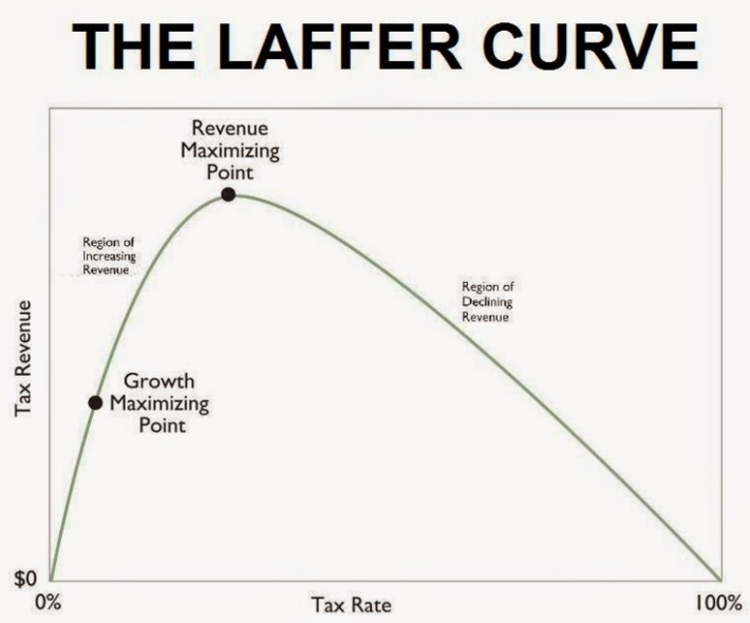
Fiscal Policy: Direct Taxes and Laffer Curve (Arthur Laffer, US)
10 bn
1 bn
No incentive to work!
0 billion
0%
15%
60%
100%
Notes:
Though he says he did not invent it.

Slide 13
Laffer (PHD) : Direct Taxes: lower “rates” = higher revenue
Trump 2017
IT Top Rate: 39.6%-> 35%
Modi 2017
IT 10%->5%
MSME: 25% [50 cr.]
Future Corporation Tax: 30%->25%
Corporation Tax: 35%->15% [exemption, deduction]
Purpose: ▼outsourcing & offshore biz by MNCs
(in theory) Laffer : revenue collection ▲
Our budget came first, before Trump announced his tax-cuts.
But only 4% of your voters are tax-payer. So, You can never match us in 'revenue collection'! You're basically a tax non-compliant society- your FM said that in Budget-2017 itself. :P :P :P
Follow Laffer Curve
CRISIS ☹
NPA, “protectionism” : “Fiscal stimulus”
True that more PAN, IT return
Revenue Collection?
Black Money recovery. Even PMGKY hardly 5k cr. declared

Slide 14
AE
Counter cyclic: Fiscal Activism, stimulus, Tax Breaks
Near Zero interest monetary policy
India
Fiscal prudence : Debt:GDP, Primary Deficit is high
Inflation is high, so can't do.
Fiscal Policy
Monetary Policy
Notes:
boost in demand, indirect tax will pay for itself

Slide 15
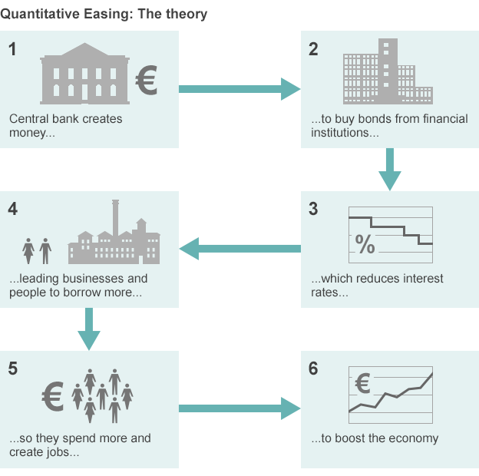
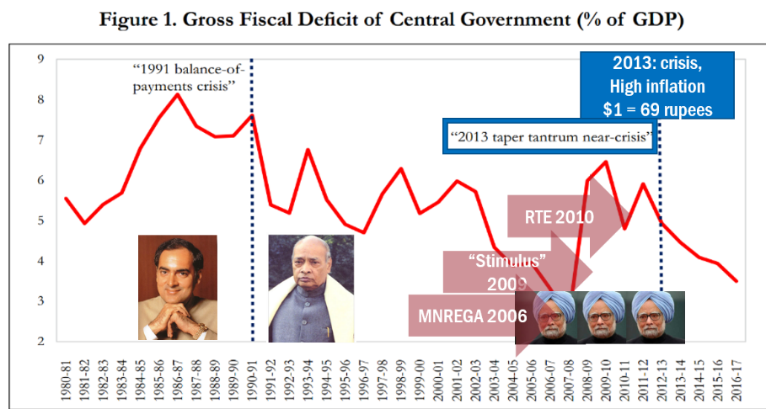
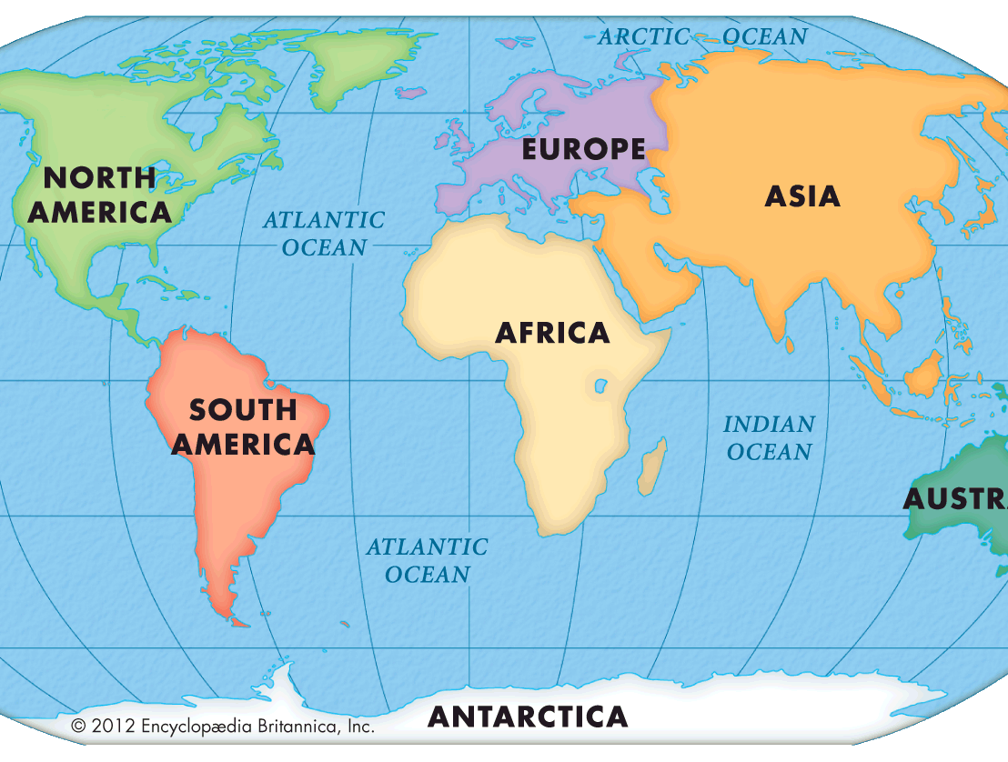
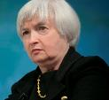
Flight of Capital
Exchange rate volatility
Weaker rupee= crude oil-> inflation
But then “TAPERING”…gradual decrease in bond purchase
NPA solution: RBI QE…x
inflation▲, rupee weak ▼
Besides, Post-demonetization MSS ☹
Notes:
HINT their Economy is recovering…..

Slide 16


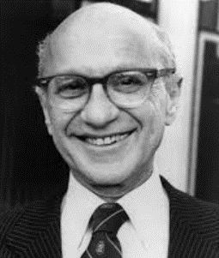
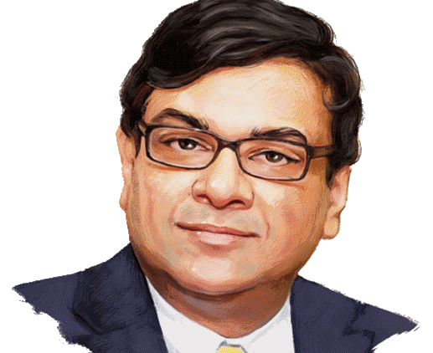



Helicopter Money: “rain of new money“: demand & production ▲
Return Principal + Interest
Purchase & Destroy
Milton Friedman: US Economist. And ECB was thinking abt it in 2016 for EU-slowdown.
Can we throw money from Helicopter? No
RGSLLY: Demand pull Inflation. (2-6%) + OPEC Cuts
Demonetization: growth rate ▼ or to give “UBI”
Notes:
IF Central Bank drops money from helicopter to restart economy

Slide 17
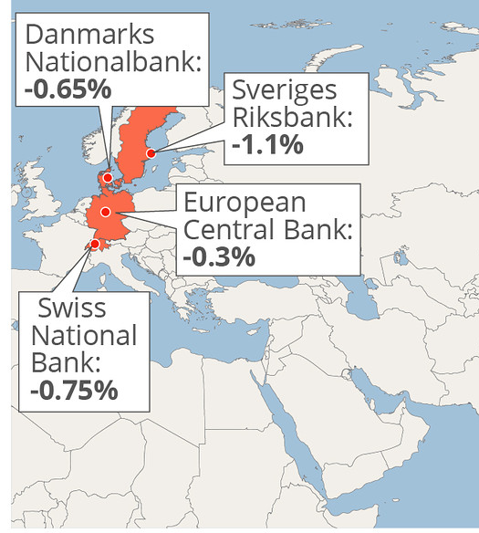
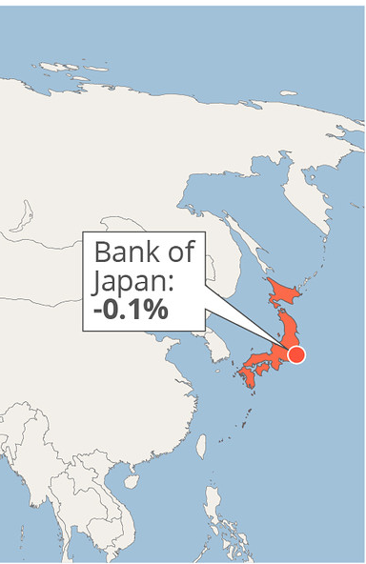
Negative interest rate? Central bank penalizes commercial banks/FI for parking money there.
Started in 2012 to protect against “Hot Money”
~Zero “Repo Rate”
-ve Interest on Deposit @Central Bank
Commercial Banks forced to “Lend”
Cheaper consumer credit
Demand-> Deflation, slowdown..x
Even Post Dem
6.75%-7.50% growth
2016: Japan latest
Banks cautious in lending, due to past NPA|TBS
India can’t Copy because
Inflation
Repo high

Slide 18
According to Economic survey 2016-17, which of the following measure(s) can be used to tackle the NPA & TBS problem in India?
Use of Negative interest rate policy
Use of Helicopter money
Use of Fiscal Stimulus
Answer Choices
a) Only 1 and 2 (b) Only 2 and 3
c) Only 1 and 3 (d) None of them

Slide 19
AE
Counter cyclic: Fiscal Activism, stimulus
Near Zero interest monetary policy, helicopter money, QE
India
Fiscal prudence : Debt:GDP, Primary Deficit is high
We don’t have “grim” slowdown / deflation. Inflation combating: so can't do.
Fiscal Policy
Monetary Policy
+ What about “Share market” Policy? (Financial market)
Notes:
boost in demand, indirect tax will pay for itself

Slide 20


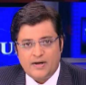

Chinese media encourages households to invest in share market.
Cos. Can issue new debt securities to fix their mess
9 crore new DEMAT accounts, 80% not even college graduate
Bubble: 150% rise in index
2015 July-Aug: Shanghai Stock exchange 30% collapse
Then China’s RBI, China’s EPFO had to pump >$1 trillion to stabilize the market.
“RGSLLY” => inflation ▲=> export ▼ Mfg.
So we can’t copy such model, for NPA solution. E.g. Using Modi’s “Mann ki Baat” to mobilize household savings towards NPA- resolution bonds.

Slide 21
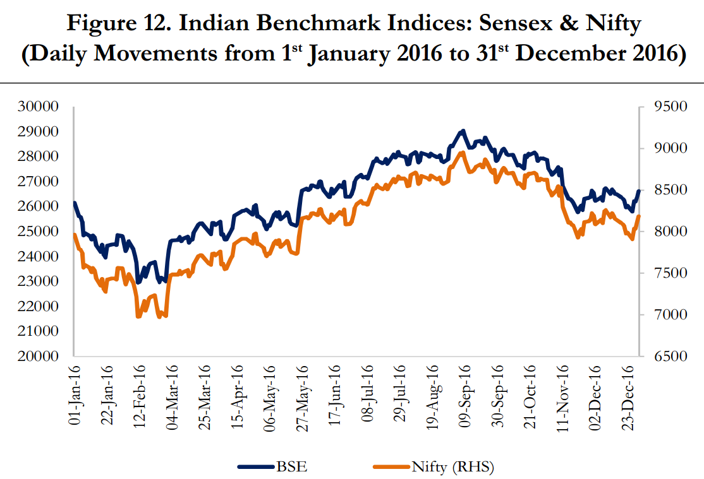
Already learned this in Financial Market lecture link
New Governor, rate cut
SENSEX: 800 pt. ▼“Bloodbath” “Bearhug”
▼Q3 profit SBI, Tata et al.
US fed: US & global turmoil
OPEC deal for cutback
Demonetization (385)
US Election outcome [IT, Pharma ▼]
BREXIT referendum
Lesson: global issues affect SENSEX: Presently >30k, but if you encourage lower middle class/ poor people to invest..they may invest all of it, then loose most of it. We’ve to work towards Fin. Inclusion & Fin. Literacy
So can’t copy Chinese model.

Slide 22
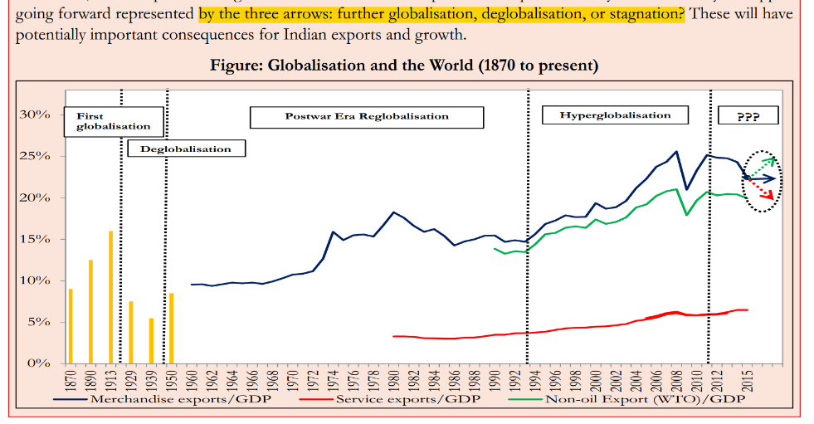
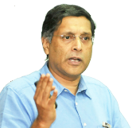
India’s export depend ☹
These 1st world countries' leaders, local vote-bank appeasement – how much 'protectionism vs. globalization’ they’ll do?- that’ll decide India's export performance.
Notes:
2005
Service export 51 bn$
2015
155 bn$
hence
Service led “growth”

Slide 23

India
Labour mobility (H1B). Mukesh Ambani- “reverse brain drain”
China
China mfg=> more job loss to USA than India’s call centres.
So, Trump’s “protectionism” on “goods” will be more..
USA Taxes against outsourcing [but more against goods than ‘services’].
I don’t fear USA. क्योकि जितने पत्ते 11th Jingping के हाथ में होते है, उतने ही उसकी आस्तीन [forex reserve] में भी होते है.
CEA Arvind believes that “To appease my vote bank, I’ll take action against both of you. But my anger & actions will be more against China!”
Notes:
Political carrying capacity for Globalization
India’s export depends on it
And so does India's growth. Esp. service sector.
Labour mobility (H1B)
Taxes against outsourcing [but more against goods than ‘services’].
Chinese
Job loss in mfg (more)
Then job loss in outsourcing by India, because their IT specialists can always find jobs in higher end computing.
So ‘political opinion’, may be greater against China, than India.

Slide 24
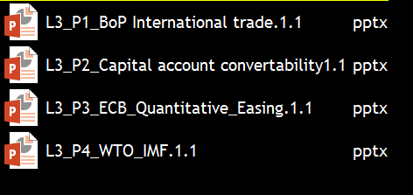

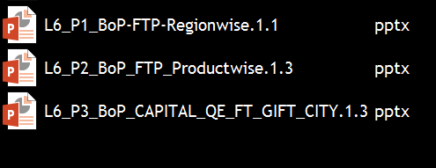
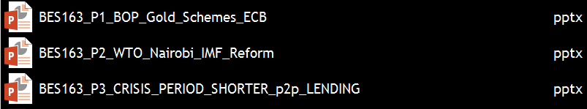

International Trade: has been the most ‘fragmented series’ ☹
BES173: theory, current
BoP-Current
BoP-Capital
Orgs
Survey Ch.5

Slide 25
Economy: 6 pillars + theory + current + BES17 (pre cum Mains)
1.Banking, Fin, Insur.
6.HRD
2.Budget
3.BoP
4.Sectors
5.Infra
V1:c3,4
V1:c2,3, 6,9,11(GST),13
V1c:5
V1c:7,11(Agri)
V1c:10
v1c:12, 14; Budget^Rail

